Slide 1

TABLEAU PROJECT
COMPARISON OF SALES BETWEEN
CENTRAL AND SOUTH REGIONS
Presented By
M Dhanush

Slide 2
AGENDA
06
Average Sales per Order by Category
01
Introduction
07
Number of Customer by Category
02
Data Source & Methodology
08
Number of Products in Sales
03
Overview of Dashboard
09
Number of Order
04
Total Sales & Profit Comparison
Key Findings:
i. Comparison
ii. Summary
10
05
First Order Date
11
Recommendations

Slide 3

INTRODUCTION
For this project, I compared the sales, profit, average sales per order by category, number of consumers we acquired in the two regions, number of products sold in each region, and number of orders placed in central and southern regions.
This comparison provides detailed insight into the factors that need to be prioritized for improved improvement in both regions.

Slide 4


DATA SOURCE & METHODOLOGY
Data Source : Sample Superstore Data
Methodology :
In this analysis, we utilized a comprehensive data-driven approach to compare sales performance between the Central and South regions.
The primary tool used for data visualization and analysis is Tableau, which allows for interactive and detailed visual representations of the data.
This methodology enables us to effectively identify patterns, trends, and insights that inform our strategic recommendations.

Slide 5
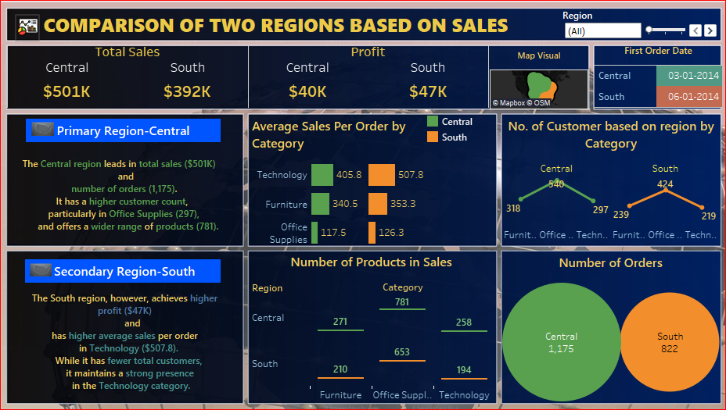
Overview of dashboard

Slide 6

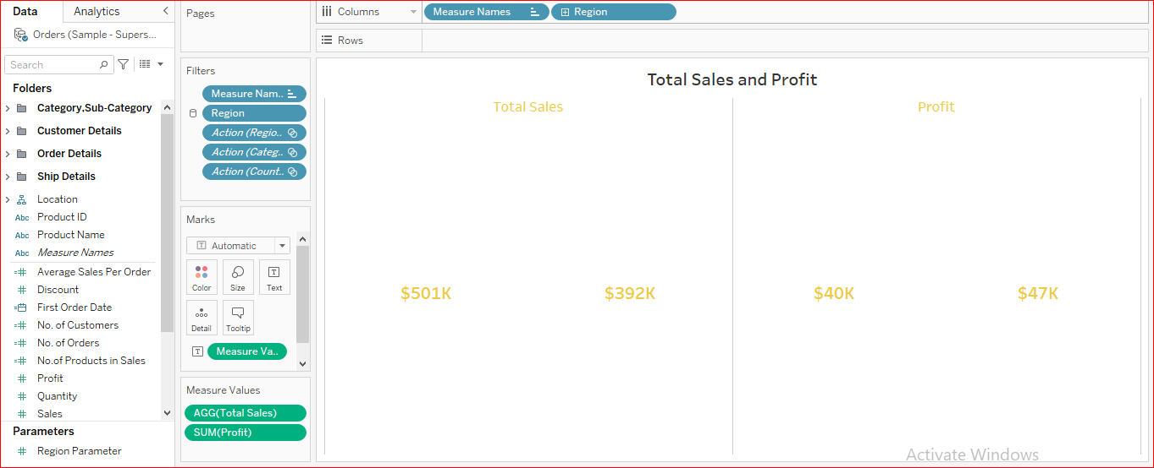
TOTAL SALES & PROFIT COMPARISON
Total Sales: The Central region leads with a total sales amount of $501K.
Profit: Despite higher sales, the profit in the Central region is $40K, which is slightly lower than the South region.
Total Sales: The South region has total sales of $392K.
Profit: Interestingly, the South region has a higher profit of $47K, indicating better profitability.

Slide 7

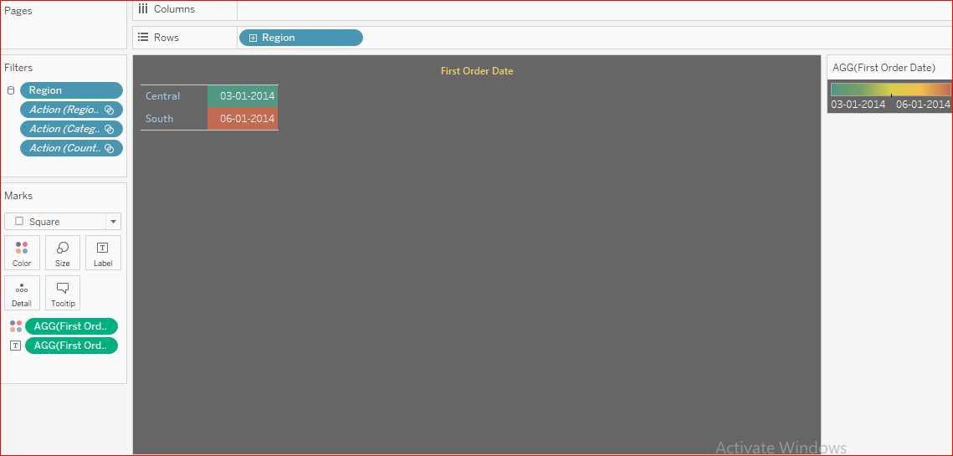
FIRST ORDER DATE

Slide 8
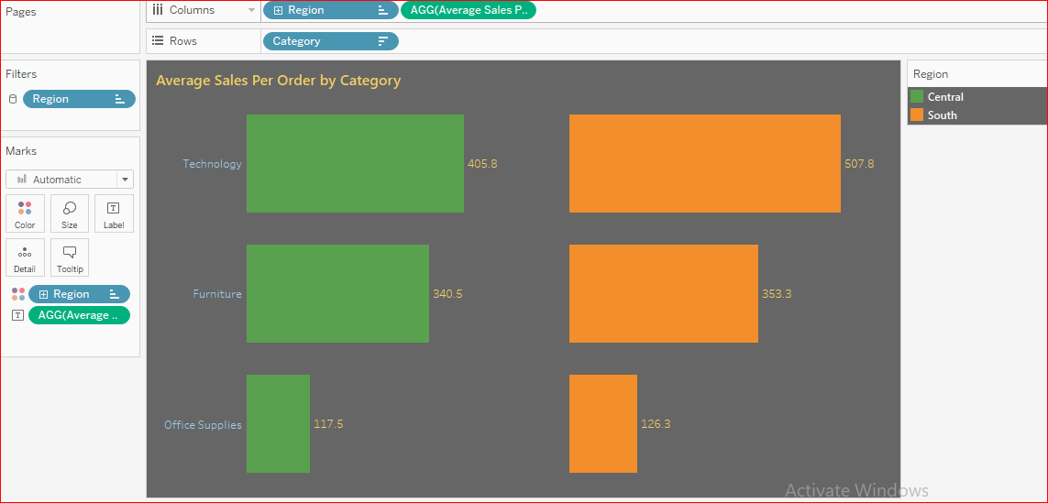
Average Sales per Order by Category

Slide 9

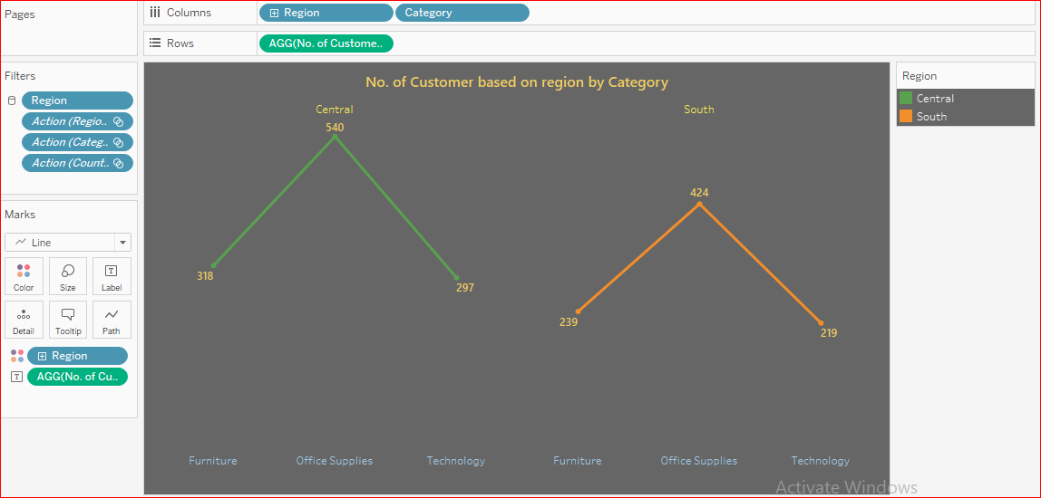
Number of Customer by Category

Slide 10
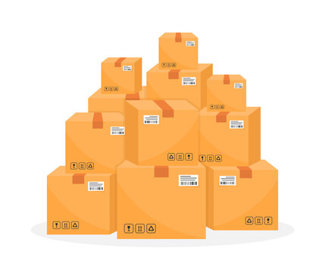
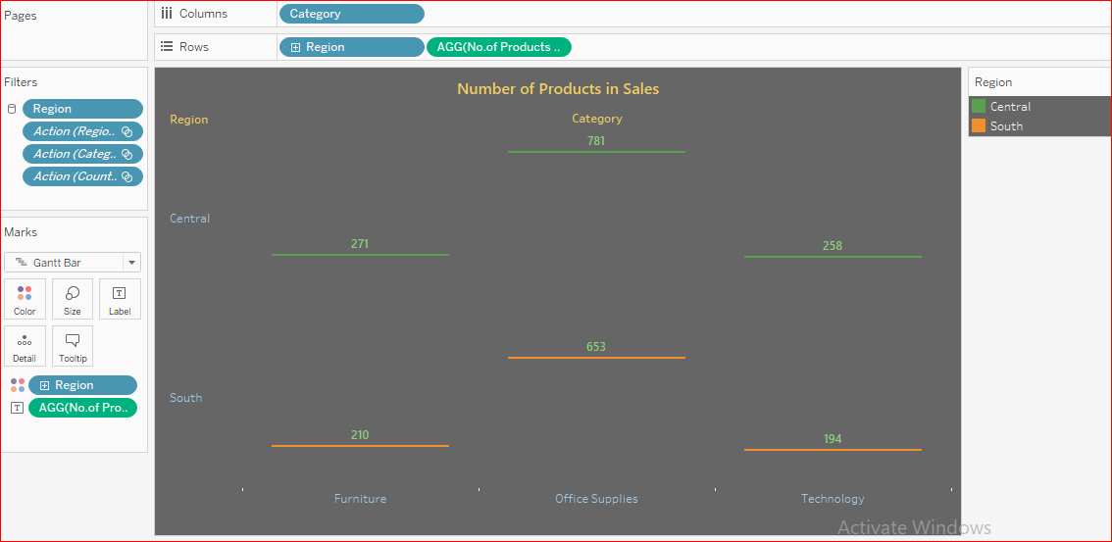
Number of Products in Sales

Slide 11

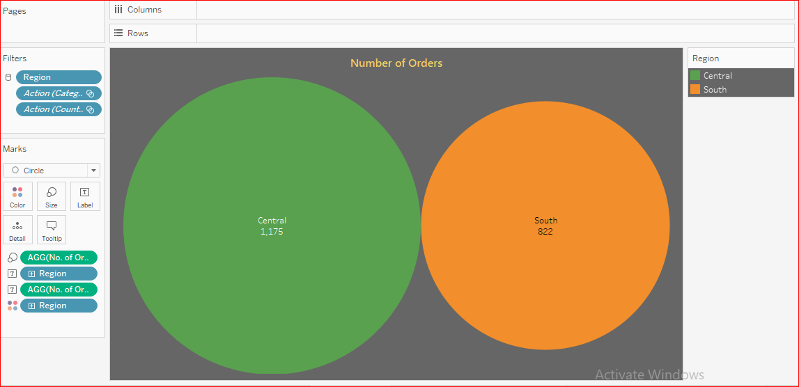
Number of Orders

Slide 12
Key Findings : COMPARISON
CENTRAL
SOUTH
Total Sales: $501K (Higher)
Profit: $40K
Number of Orders: 1,175 (Higher)
Number of Customers: Higher in Office Supplies (297)
Product Range: 781 products (Higher)
Average Sales Per Order:
Technology: $405.8
Furniture: $340.5
Office Supplies: $117.5
Total Sales: $392K
Profit: $47K (Higher)
Number of Orders: 822
Number of Customers: Strong in Technology (219)
Product Range: 653 products
Average Sales Per Order:
Technology: $507.8 (Higher)
Furniture: $353.3 (Higher)
Office Supplies: $126.3 (Higher)

Slide 13

KEY FINDINGS : SUMMARY
The Central region excels in total sales, number of orders, and product range, with a strong customer base in Office Supplies. However, the South region is more profitable and leads in average sales per order for Technology, demonstrating a focused strength despite fewer overall customers and orders.
RECOMMENDATIONS
Data-Driven Decision Making:
Regularly analyze sales data to identify trends and opportunities. Use this data to make informed decisions about inventory, marketing, and customer engagement.
Customer Feedback:
Collect and analyze customer feedback to understand their needs and preferences. Use this information to improve product offerings and customer service.
Digital Marketing:
Invest in digital marketing strategies, including social media, email campaigns, and SEO, to reach a broader audience and drive online sales.
Training and Development:
Train sales and customer service teams to improve their skills and knowledge. Well-informed and motivated staff can significantly impact sales and customer satisfaction.

Slide 14
THANK YOU

